Slide 2
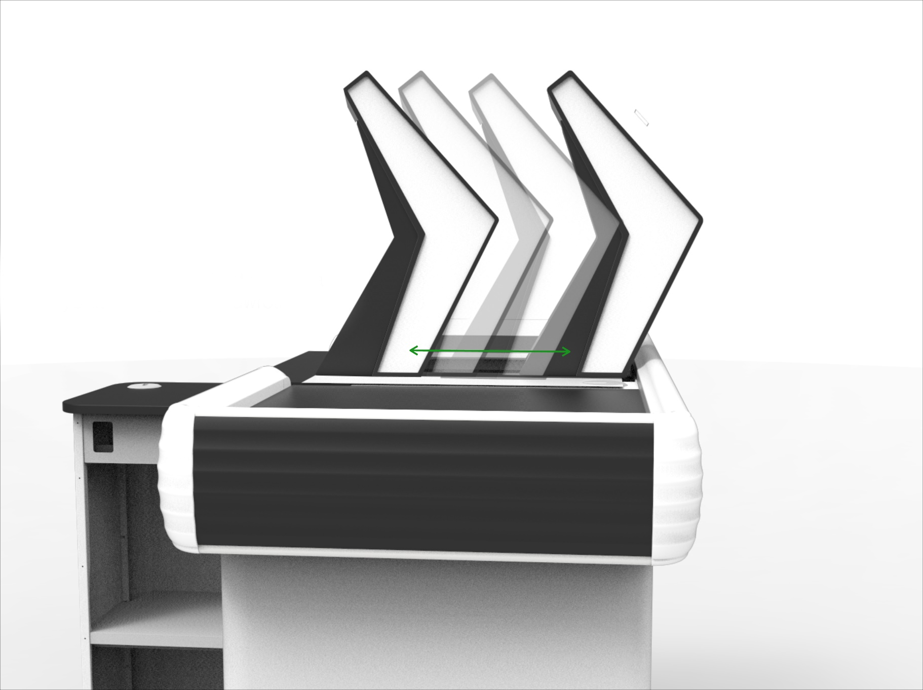
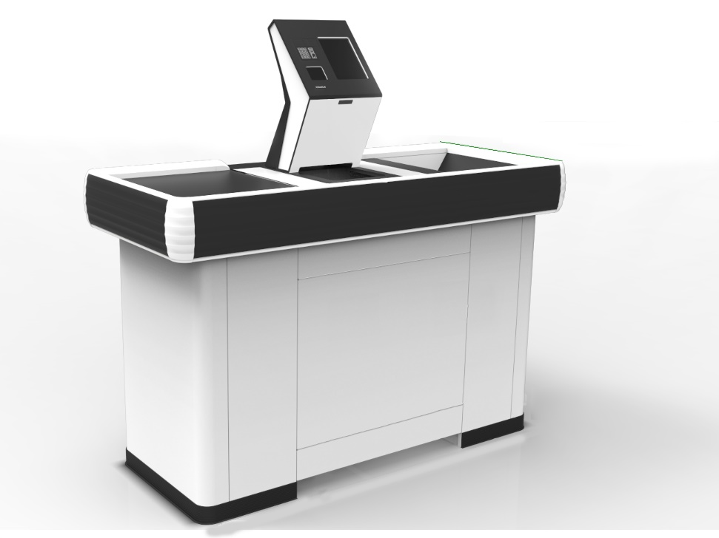
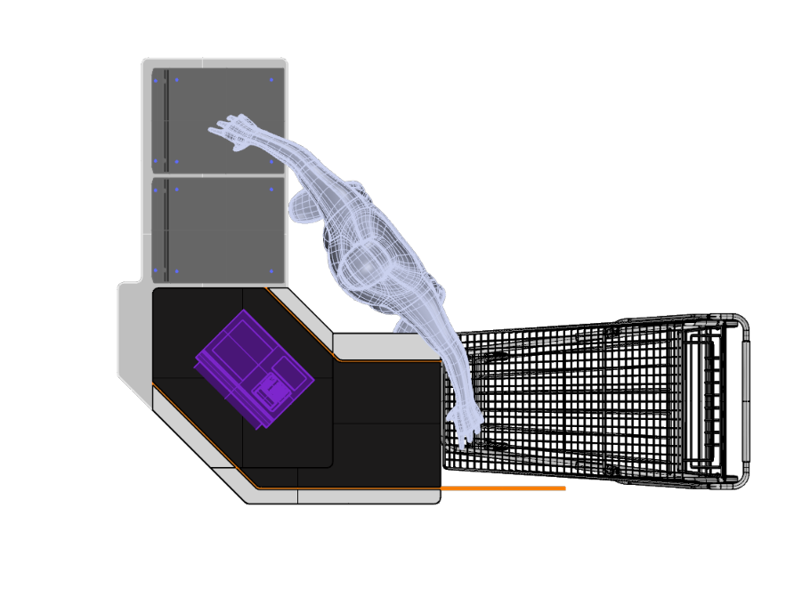

Slide 3
SPINNAKER DF
Benefits:
All checkouts in the store can always be open
Modern, innovative design
Fast implementation due to the possibility to use existing store cashdesk infrastructure
Making the Spinnaker head customizable and separating the scanning process from the payment we can offer economically optimal configuration for every client
SCO software has been optimized so the product scanning is faster and whole checkout process takes less time

Slide 4
SPINNAKER DF
Principle of operation:
Product scanning performed by the cashier
End of shift and switch to SCO mode
Product scanning performed by the client
Payment
QR code scanning and leaving the zone
1.
2.
3.
4.
5.

Slide 5
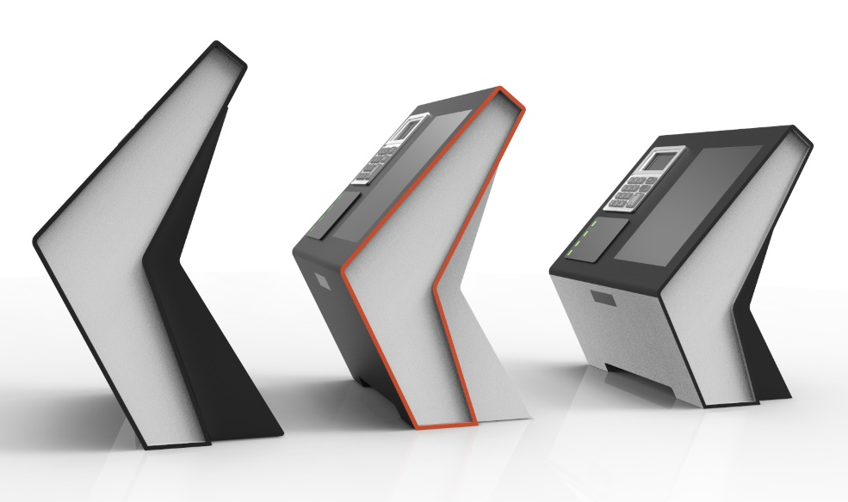
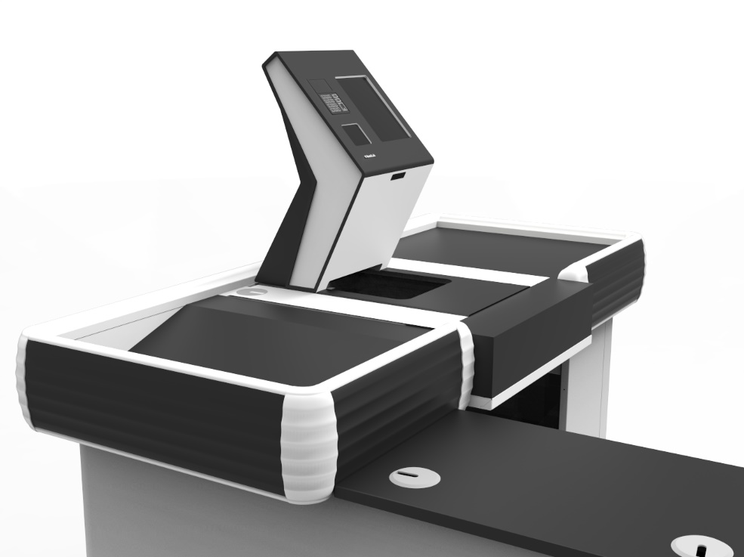
SPINNAKER DF
Overview:
Easy implementation in existing stores
No need for building a special Self-Checkout Zone
Multiple configuration options
Full management of the checkout process
Economically efficient solution

Slide 6
CONTACT
Hemitech….

